Slide 1
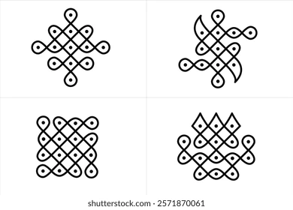
KolamKala
Rule-Based Kolam Generation and Analysis
Presented by : Palak Kolambe
Kirti Rasal
Ashvitha Sree
Course - BCA-AIML
Under the Guidance of Dr. Sandeep Kulkarni
FINAL YEAR PROJECT PRESENTATION - 2026

Slide 2
Problem Statement
No Automated Analysis
No tools to extract dots, loops, symmetry, and complexity from Kolam images.
No Computational Representation
Kolams lack a standard digital format, making algorithmic processing difficult.
Difficulty Encoding Rules
Artistic rules like continuity, symmetry, and non-overlapping paths are hard to model.
No Integrated System
Generation and analysis exist separately — no unified framework.

Slide 3
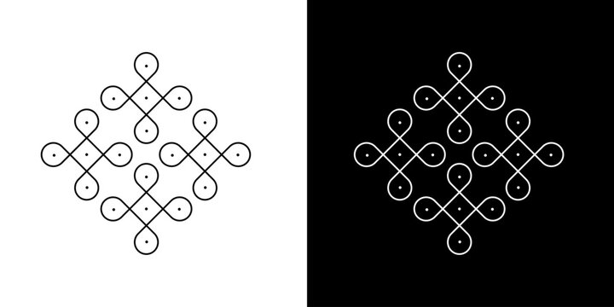
Introduction To Kolam
Kolam is a traditional geometric art form originating from South India.
It is created using dot grids (pulli) and continuous curves.
Patterns follow strict rules of symmetry, continuity, and non-overlapping paths.
Widely used for decorative and cultural purposes.
Can be modeled using computational geometry and algorithms.

Slide 4
Proposed Solution: KolamKala
KolamKala Framework
Unified system for Kolam generation and analysis
Grid-Based Modeling
Uses grid-based modeling and rule-based algorithms
Rule-Based Generation
Combines computer vision + pattern generation
Analysis & Classification
Image processing + pattern classification and complexity scoring

Slide 5
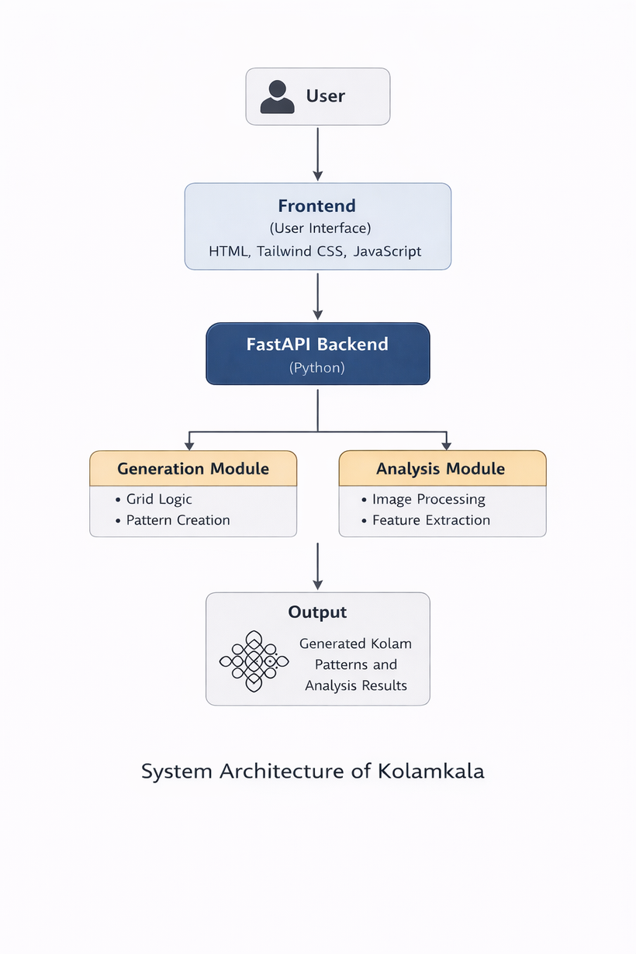
System Architecture
Client-server-based architecture.
Backend implemented using FastAPI (Python).
Modules for Pattern Generation and Pattern Analysis.
Uses OpenCV, NumPy, Matplotlib for processing.
Follows Input → Process → Output (IPO) model.

Slide 6
Kolam Generation Module
Grid Creation
Generates a dot-grid (x, y coordinates) as the base structure
Rule Engine
Applies Kolam rules (enclose dots, no retracing, valid connections)
Path Algorithm
Uses graph traversal (DFS/backtracking) to create continuous paths
Symmetry Handling
Applies reflection & rotation to ensure symmetric patterns

Slide 7
Kolam Analysis Module
Edge Detection
Detects boundaries of Kolam lines
Contour Detection
Identifies closed loops and shapes.
Hough Transform
Detects lines and dot patterns
Feature Extraction
Extracts dots, loops, symmetry
Classification
Classifies type & computes complexity

Slide 8
System Demo / User Interface
User Input
Select grid size / upload image
Choose generation or analysis mode
Processing
Backend executes generation or analysis modules
Applies algorithms and rules
Output Display
Generated Kolam pattern.
Analysis results (type, symmetry, complexity).

Slide 9
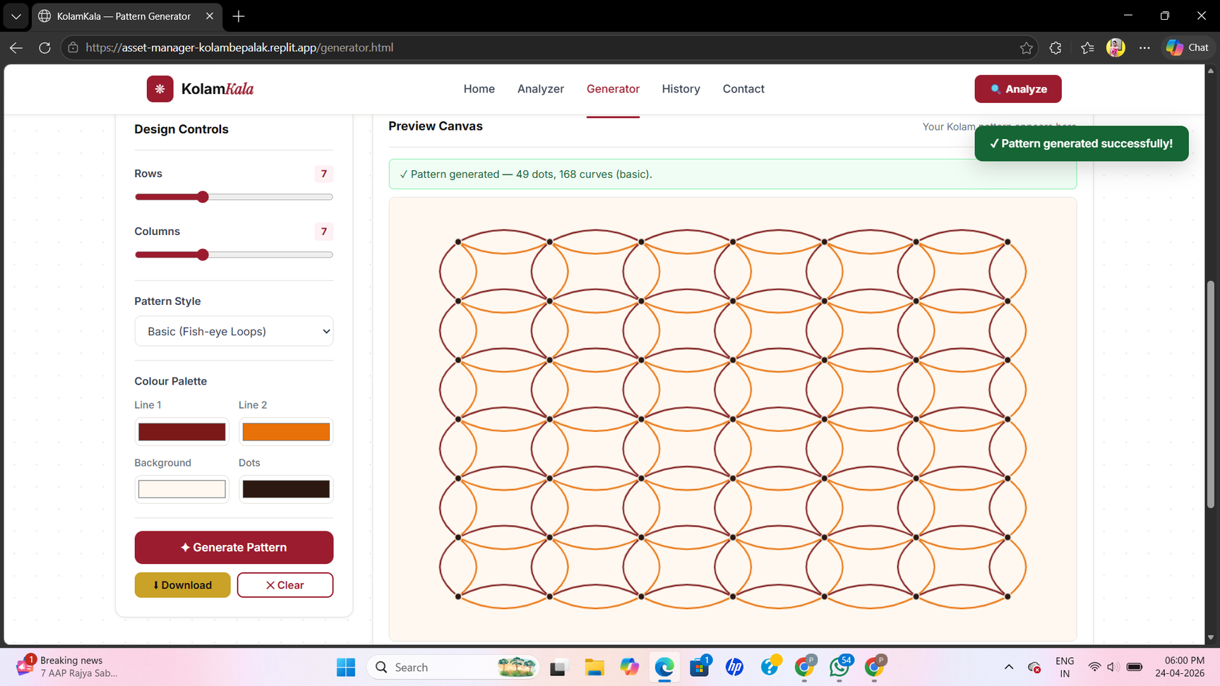

Results / System Output
Generator Module
User controls (grid size, style)
Generated Kolam pattern

Slide 10
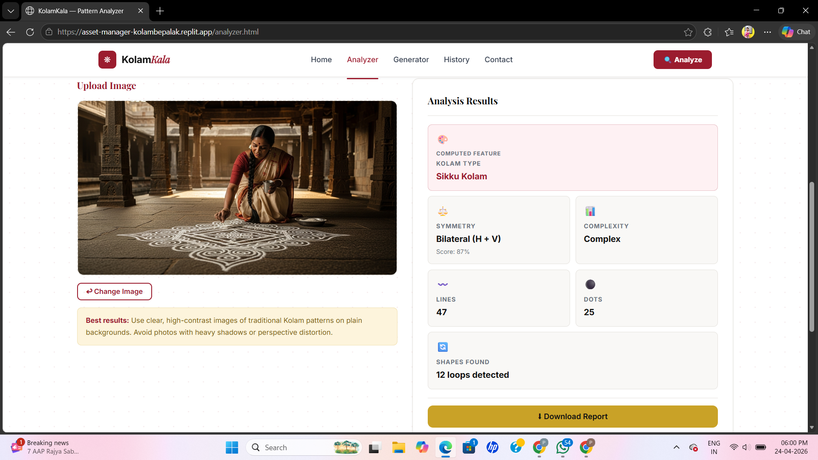
Results / System Output
Analyzer Module
Uploaded image
Detected kolam type
Extracted features & metrics

Slide 11
Limitations & Future Scope
Limitations
Future Scope
Works best with clean, high-contrast Kolam images.
Sensitive to noise, shadows, and perspective distortion.
Limited support for highly complex or irregular patterns.
Rule-based approach may not generalize to all Kolam styles.
Integrate machine learning for robust pattern recognition.
Support real-time mobile-based Kolam detection.
Expand to more Kolam styles and regional variations.
Enhance UI with interactive drawing and editing features
.

Slide 12
Conclusion
Developed a rule-based system for Kolam generation and analysis.
Successfully modeled Kolam structures using computational geometry.
Implemented both pattern generation and image-based analysis modules.
Extracted key features such as dots, loops, symmetry, and complexity.
Demonstrated a functional web-based interface with real-time results.
We designed and implemented both generation and analysis modules, integrating computational geometry and image processing into a unified system

Slide 13
Thank you
Any Questions?

